Slide 1
By Team Fun

Slide 2
Project Overview
An online IDE for both professors and students
Teachers can create and share programming problems with their students
Students can solve the problem in the language of their choice
Solutions are tested with specific test cases mandated by professors

Slide 3
Sprint 1 User Stories
Professor login
As a Professor, I want to log in, so that I can create/distribute problems to my students and track their progress
Administrator login
Professor creating a problem
As a Professor, i want to be able to create a problem, so that I can assign work to my students

Slide 4
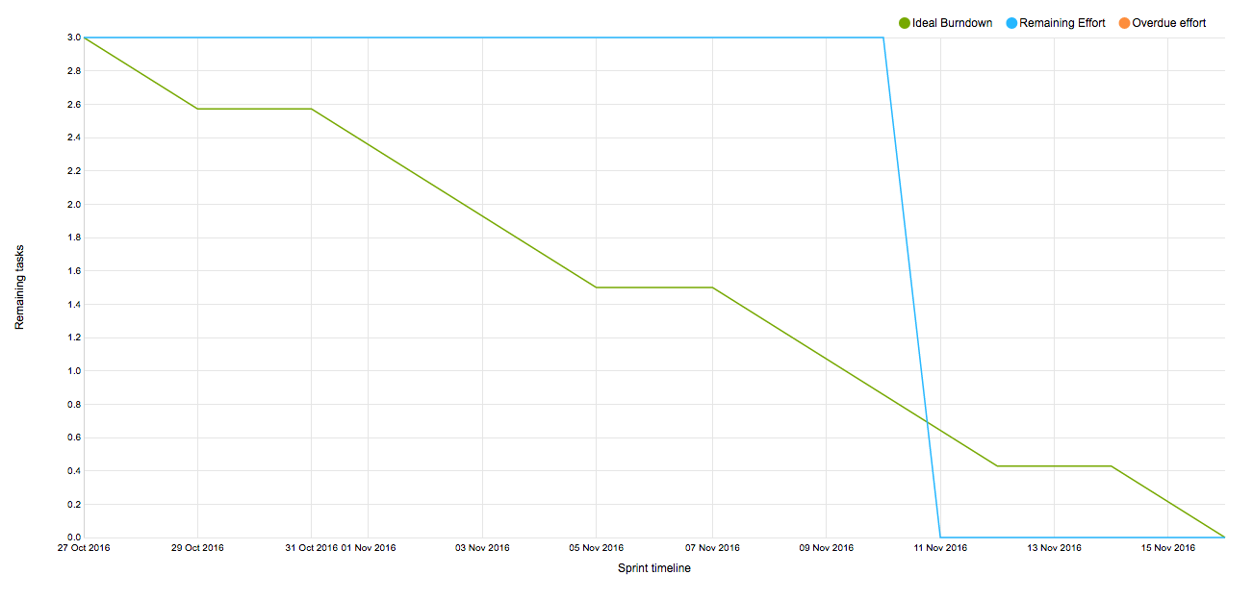
Sprint 1 Burndown Chart

Slide 5
Sprint 2 User Stories
Student login
Professor creating test cases
As a professor, I want to create test cases for a particular problem so that my students can tell if their code is a valid solution
Student coding in the editor
As a student, I want to code in an editor where it is clear what language I am working with so that I can properly complete the assignments
Student views standard output
Student has persistent data

Slide 6
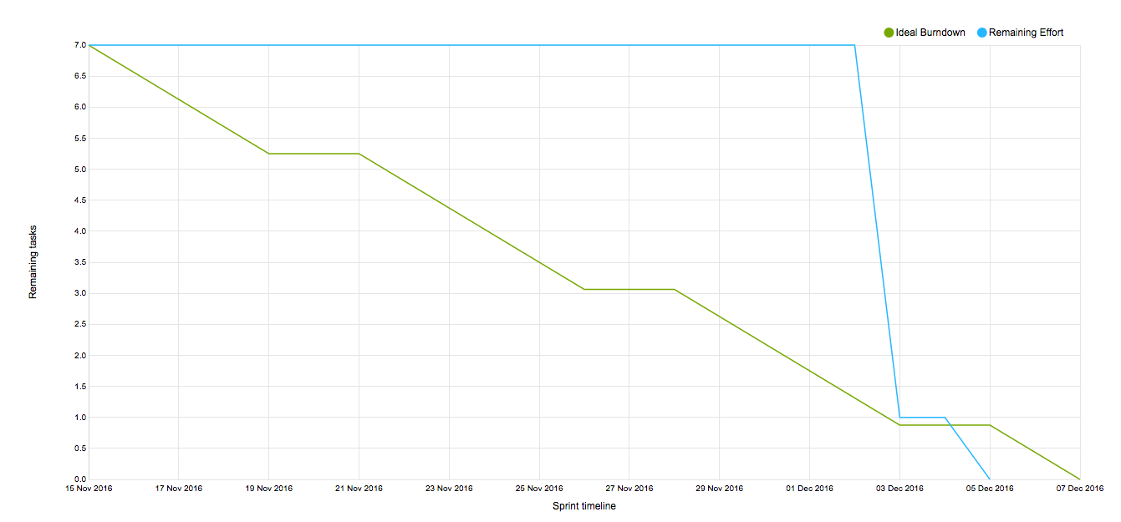
Sprint 2 Burn Down Chart

Slide 7
Team Fun Velocity
Sprint 1 : 14
Sprint 2 : 20
Average Velocity : 17

Slide 8
Improving the Process
Meeting earlier
Meeting more often
Divvying up tasks ahead of time
Reflections:
Allowed us time to adjust our sprint plans
Made us a more efficient workforce

Slide 9
Demo
http://oraserv.cs.siena.edu/~perm_team1_2016/login.html
http://oraserv.cs.siena.edu/~perm_team1_2016/makeProblem.html

Slide 10
Thanks!
Any questions?

